Slide 1
Image Restoration from Noisy & Blur Images while Preserving
Defects of Interest
EE5179 Deep Learning for Imaging – class project
Jul - Nov 2024
Github link: https://github.com/Juss-Chill/EE5179_Project
(BesT MOdel is On MAIN Branch)

Slide 2
Group Members
DA24S005 - S Gokull
ED23S300 - Muni Srinivas B
MM23S008 - Sanjeev S N
ED23S025 - Satyam Kumar Verma

Slide 3
Contents
Introduction
Restormer
SCUNET
Convolutional AutoEncoder
UNet

Slide 4
Introduction
Task: Restore images degraded by noise and blur while preserving critical defects of interest.
Algorithm: DL / Vision Transformer
Validation Metrics: PSNR and SSIM
Implementations tried by our group:
Restormer (best performance)
SCUNET
Convolutional AutoEncoder
UNet

Slide 5
Restormer Report

Slide 6
Paper Details
Zamir, S. W., Arora, A., Khan, S. H., Hayat, M., Khan, F. S., & Yang, M. (2021). Restormer: Efficient transformer for High-Resolution Image restoration. arXiv (Cornell University). https://doi.org/10.48550/arxiv.2111.09881

Slide 7
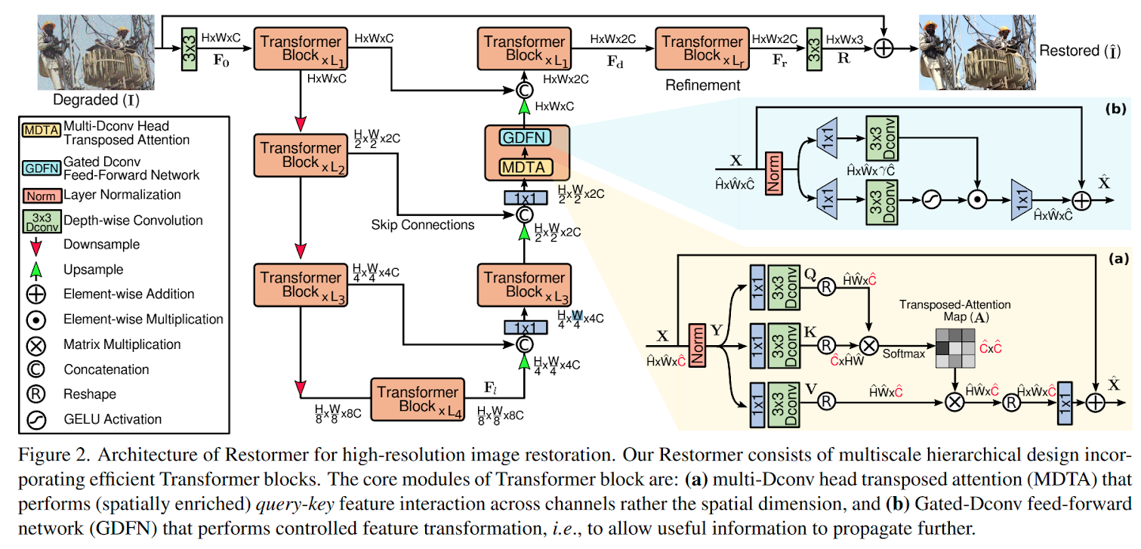
Architecture

Slide 8
Architecture
Reason for choosing this architecture:
Best performance (~40 dB PSNR, 0.956 SSIM) on a similar dataset (Darmstadt Noise Dataset)
Modifications:
We used the default architecture and trained the model on the MVTECAD dataset.

Slide 9
Training Details
Number of images: 932
Number of iterations: 96000
Gradient clipping: True
Learning rate: 3e-4 for 29440 iterations, Cosine annealing (3e-4 to 1e-6) for 66560 iterations.
Optimizer: AdamW
Weight Decay: 1e-4
Betas: [0.9, 0.999]
Metric: PSNR

Slide 10
Experiments
Input image is processed as tiles instead of whole image due to GPU memory constraints.
Validation experiments are done for different tile sizes and tile overlap sizes.
(Tile size, Tile overlap size) of (256, 64) gives best performance. Hence, the results generated by this combination are considered.

Slide 11
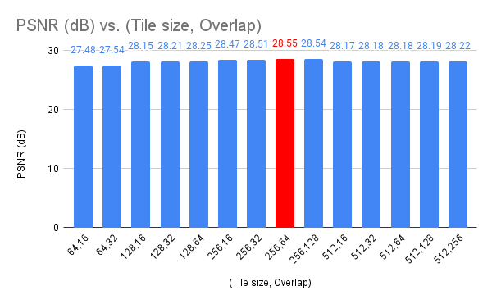
Experiments

Slide 12
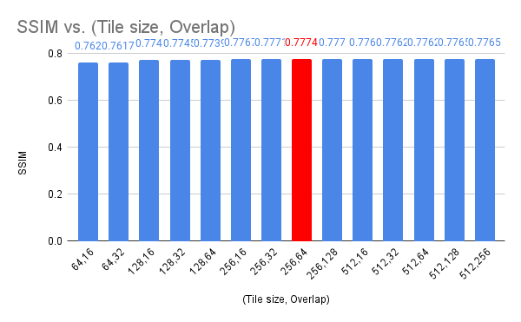
Experiments

Slide 13
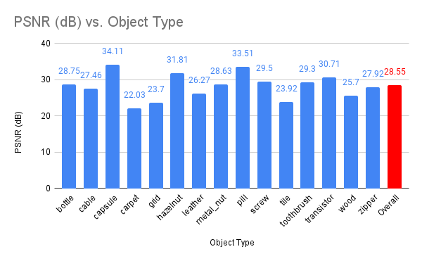
Results on Validation Set
PSNR on entire validation set: 28.55 dB

Slide 14
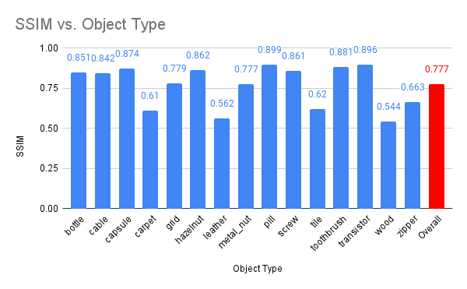
Results on Validation Set
SSIM on entire validation set: 0.7774

Slide 15
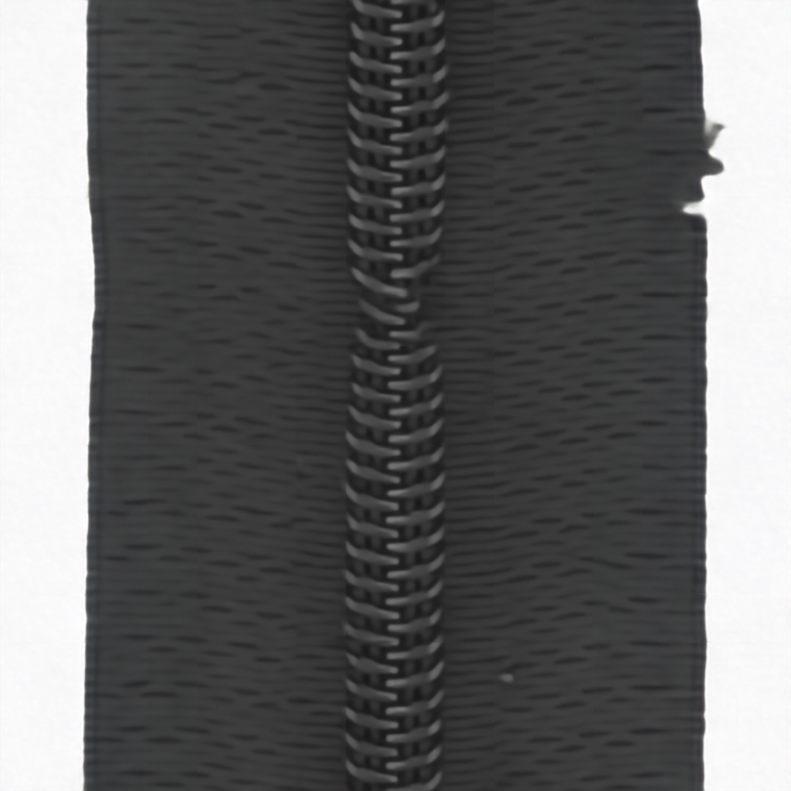
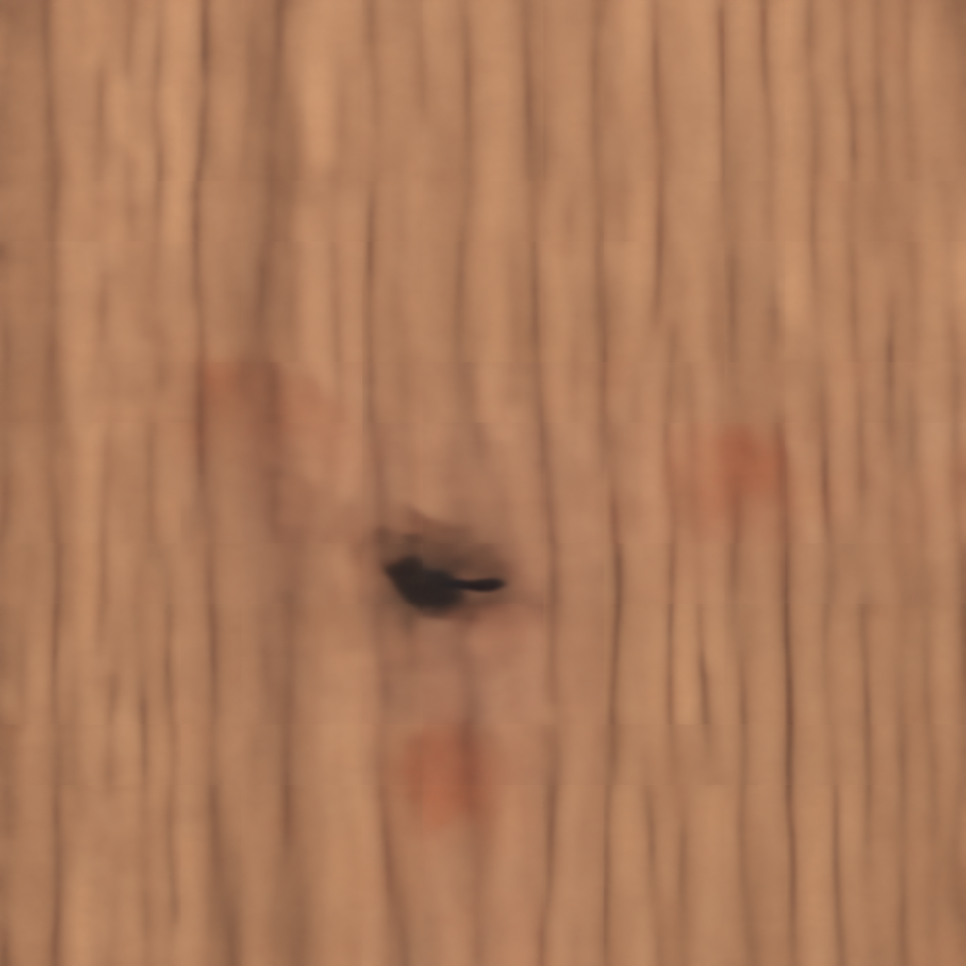
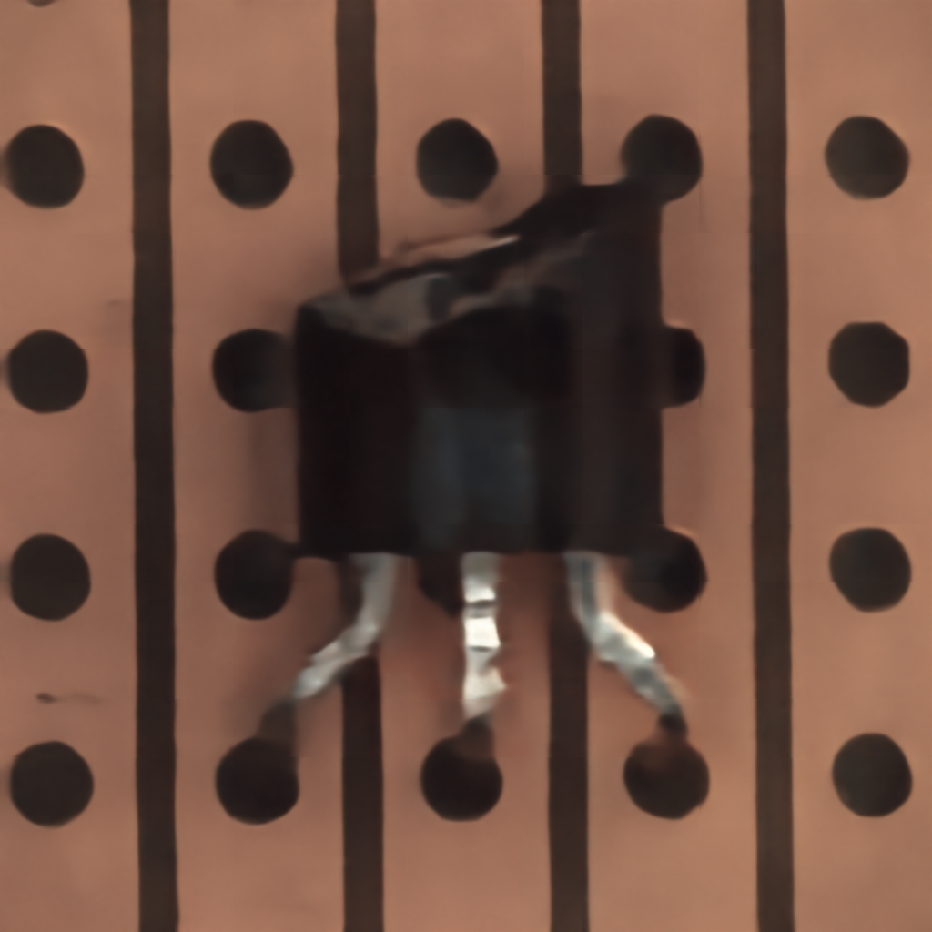
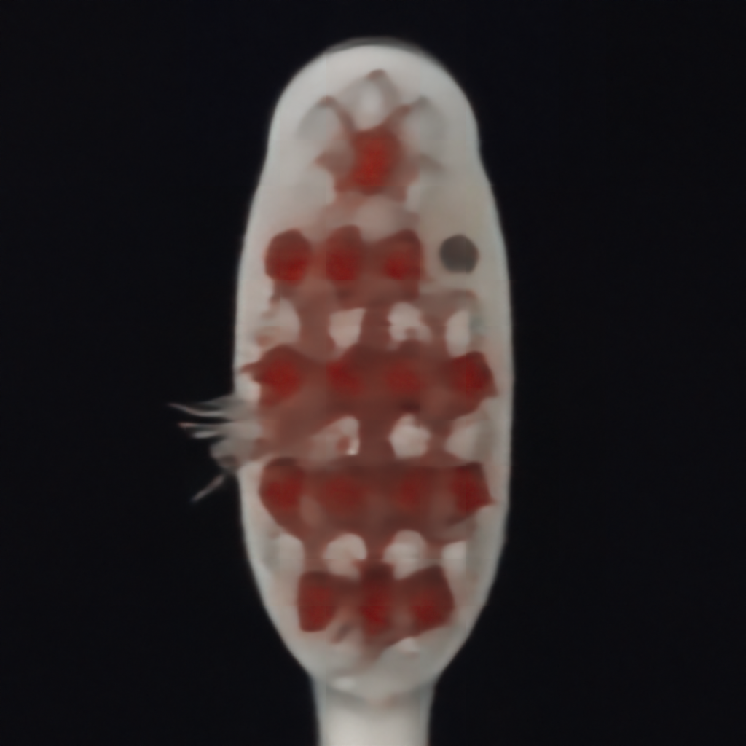
Reconstructed Images

Slide 16
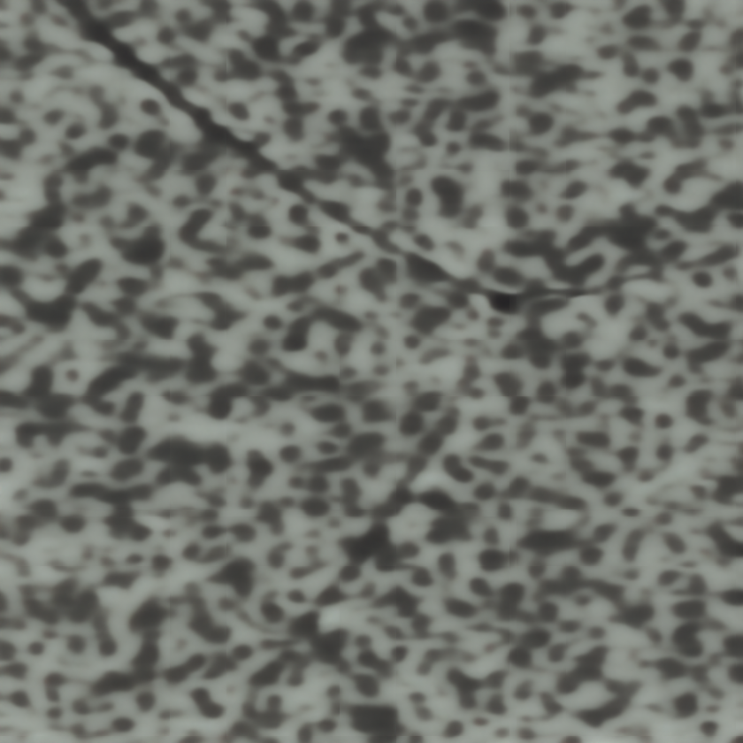
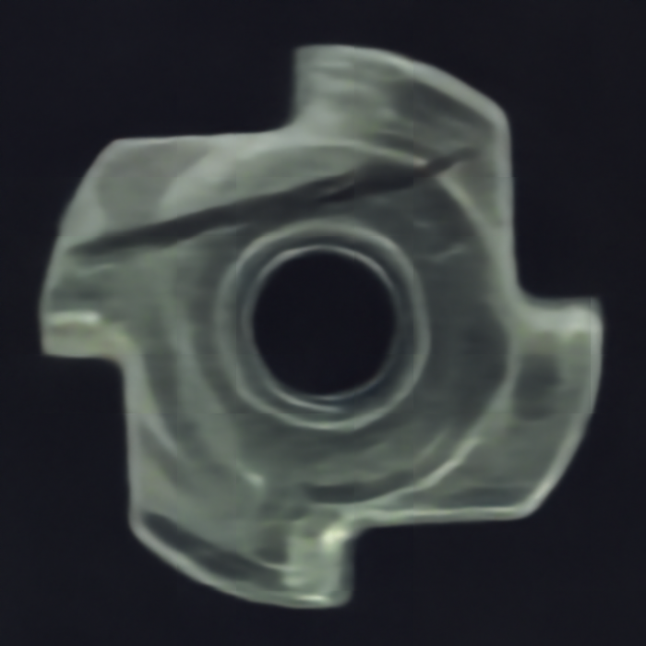
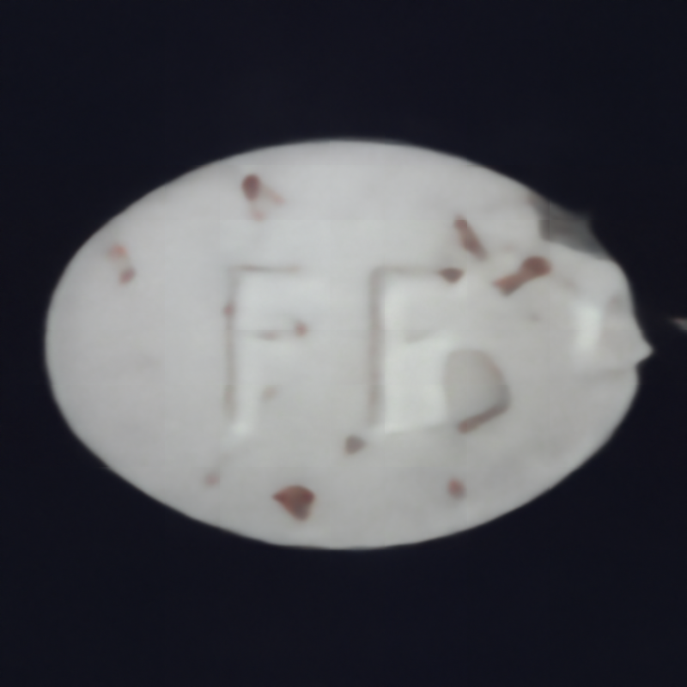
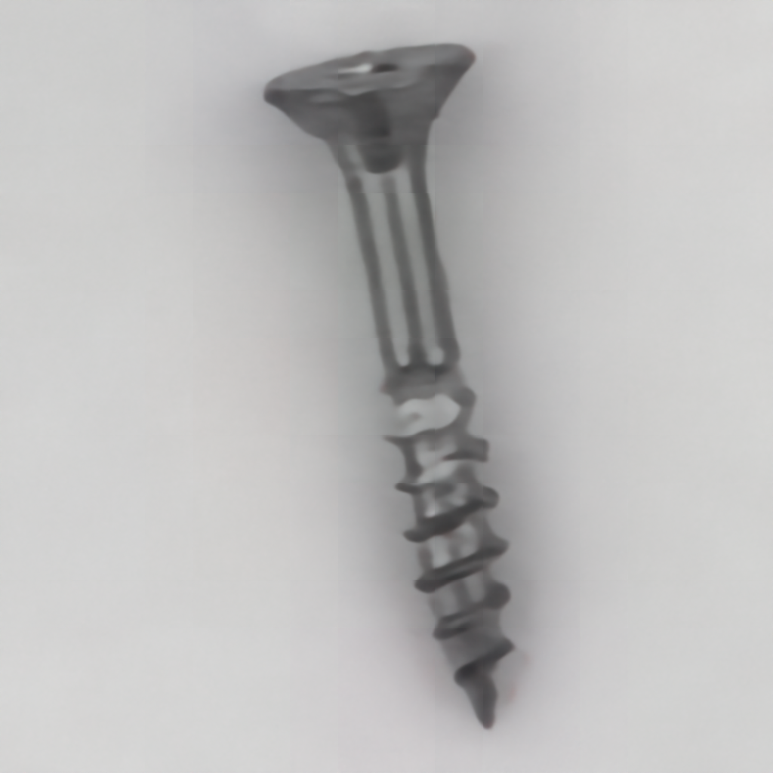
Reconstructed Images

Slide 17
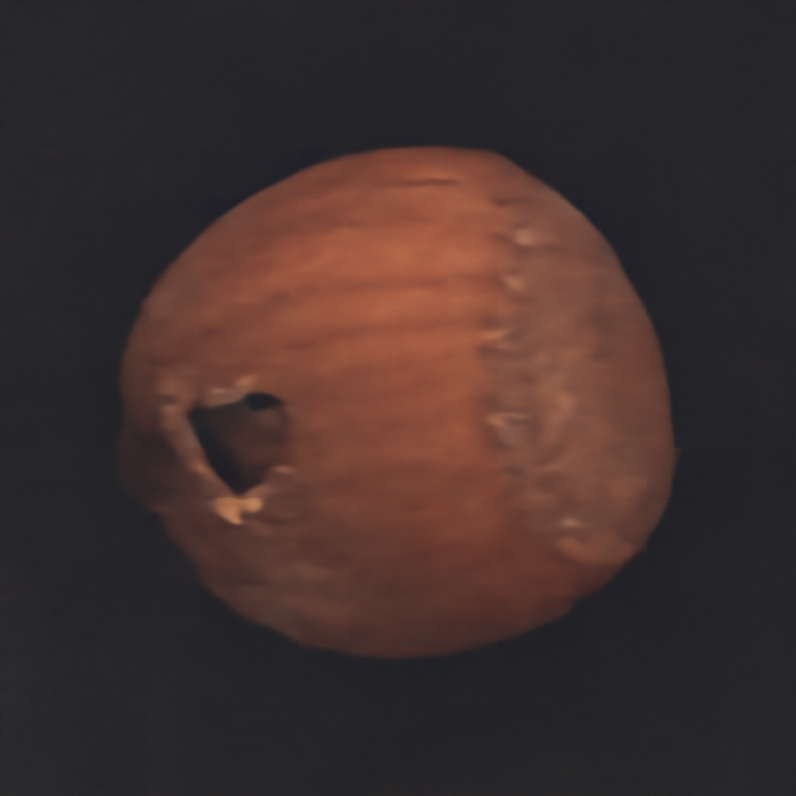
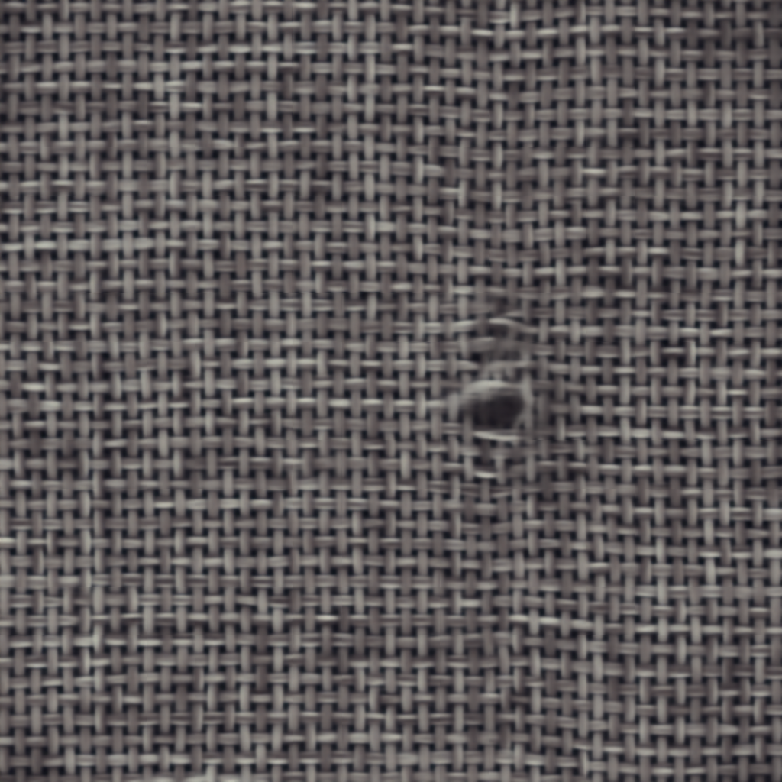
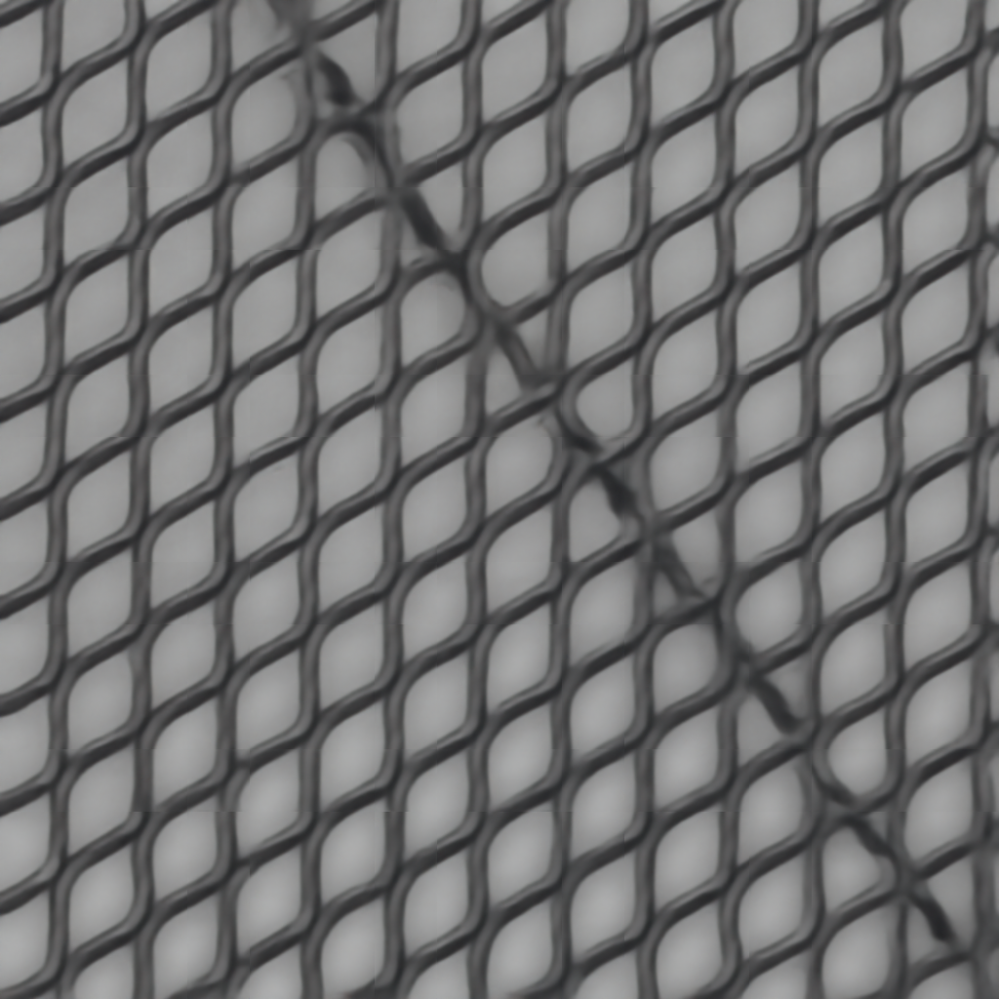
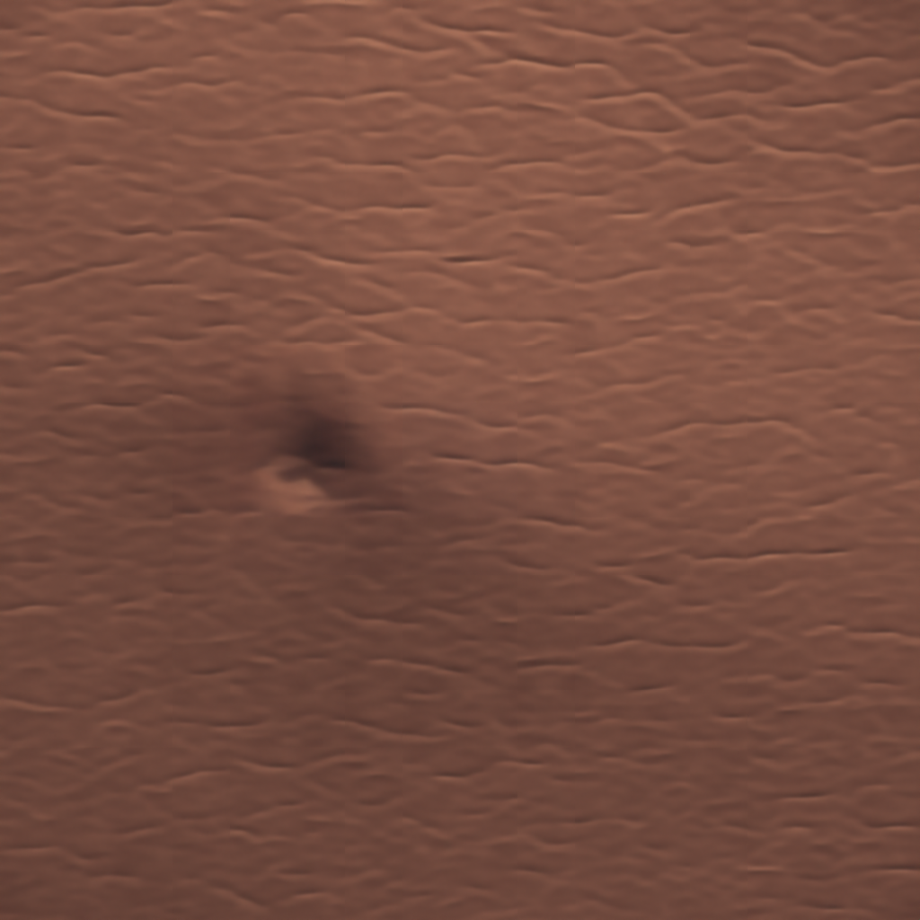
Reconstructed Images

Slide 18
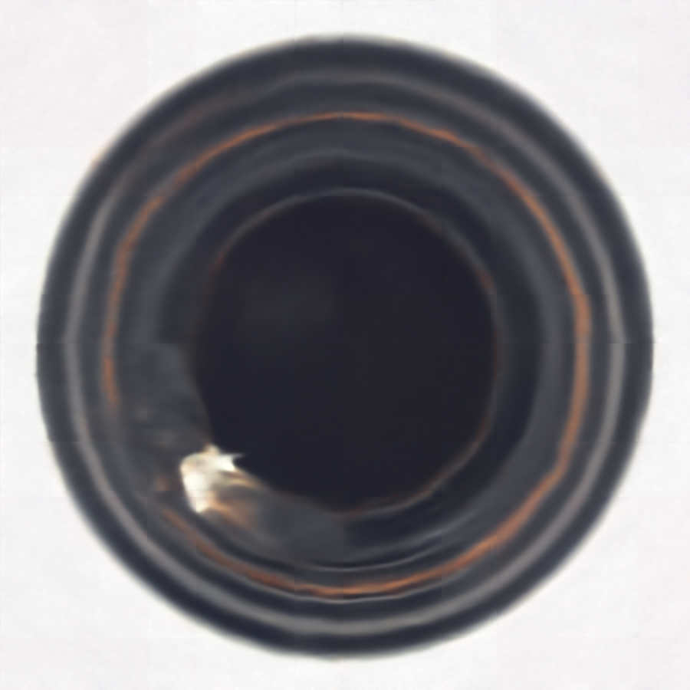
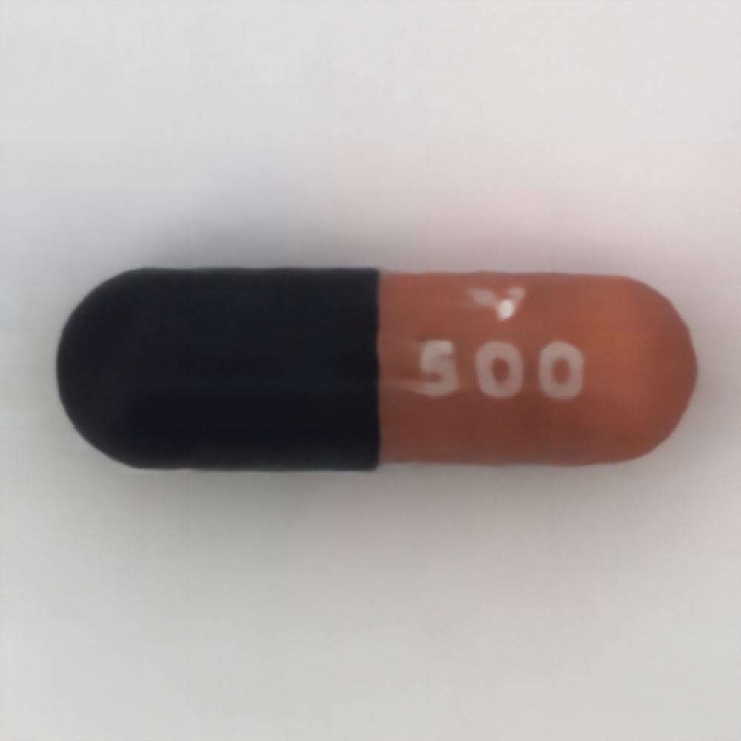
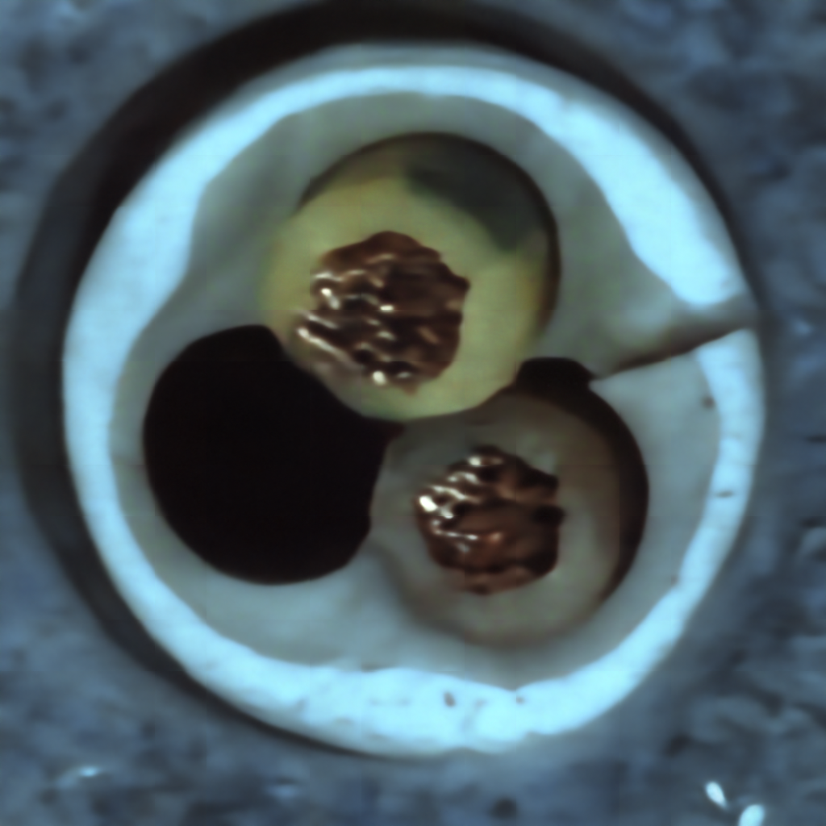
Reconstructed Images

Slide 19
SCUNET Report

Slide 20
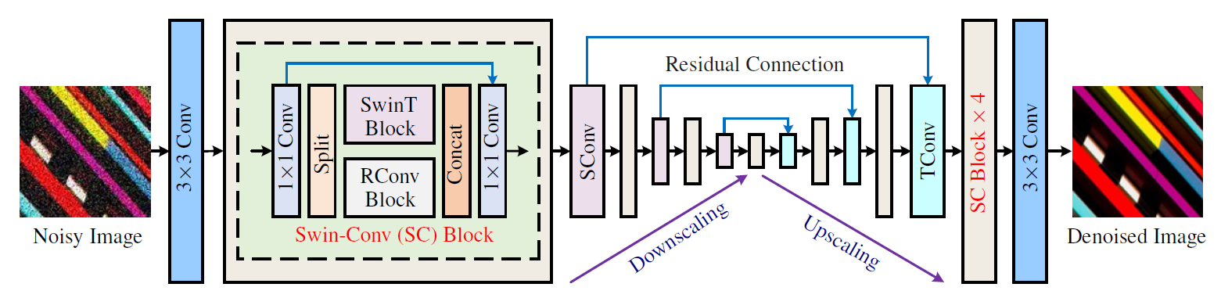
Model Architecture - ScuNet
Paper link : https://arxiv.org/pdf/2203.13278
Citation : Zhang, K., Li, Y., Liang, J. et al. Practical Blind Image Denoising via Swin-Conv-UNet and Data Synthesis. Mach. Intell. Res. 20, 822–836 (2023). https://doi.org/10.1007/s11633-023-1466-0

Slide 21
Class | Epochs = 50 |  | Epochs = 100 |  | Epochs = 150 |  | Epochs = 200
 | PSNR | SSIM | PSNR | SSIM | PSNR | SSIM | PSNR | SSIM
Bottle | 29.2687 | 0.8835 | 30.5046 | 0.8866 | 30.5237 | 0.8894 | 30.2843 | 0.88636
Cable | 17.40879 | 0.44996 | 17.4441 | 0.4458 | 17.1526 | 0.44425 | 17.3423 | 0.43312
Capsule | 16.51 | 0.2465 | 28.8095 | 0.8704 | 29.0696 | 0.87056 | 28.1470 | 0.8691
Carpet | 17.5406 | 0.29934 | 17.7514 | 0.2936 | 17.6359 | 0.2931 | 17.42 | 0.299
Grid | 16.5135 | 0.24656 | 16.5910 | 0.24819 | 16.637 | 0.24547 | 16.663 | 0.24967
Hazelnut | 22.62002 | 0.78044 | 22.9756 | 0.7754 | 22.6856 | 0.77903 | 22.559 | 0.7645
Leather | 23.551 | 0.4025 | 23.7281 | 0.39674 | 23.9969 | 0.39769 | 23.3753 | 0.39140
Metal nut | 17.2246 | 0.5542 | 17.1273 | 0.5540 | 16.8841 | 0.55048 | 17.0177 | 0.54680
Pill | 26.4830 | 0.83851 | 27.2398 | 0.83708 | 26.7589 | 0.83934 | 27.1981 | 0.8301
Screw | 17.8265 | 0.7630 | 17.822 | 0.76280 | 17.1993 | 0.7614 | 18.1474 | 0.7618
Tile | 17.6185 | 0.20306 | 17.3961 | 0.1934 | 16.7840 | 0.1895 | 17.2588 | 0.1846
Truth brush | 27.2639 | 0.8599 | 30.1762 | 0.87765 | 29.1604 | 0.8772 | 28.7491 | 0.8718
Transistor | 20.5161 | 0.6821 | 21.8324 | 0.68409 | 21.4560 | 0.6820 | 21.751 | 0.6795
Wood | 20.1684 | 0.361780 | 21.3461 | 0.3622 | 22.1571 | 0.3813 | 20.7846 | 0.3202
Zipper | 20.842 | 0.48961 | 20.7025 | 0.4774 | 20.7978 | 0.18955 | 20.5258 | 0.4736

Slide 22
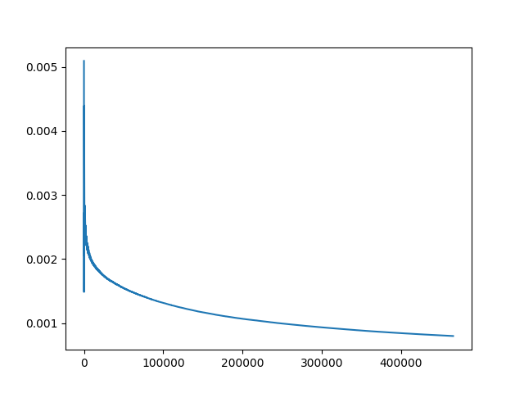
Average PSNR and SSIM Values
Epochs | 50 | 100 | 150 | 200
Average PSNR | 20.757 | 22.0964 | 21.926 | 21.8148
Average SSIM | 0.5373 | 0.577 | 0.5593 | 0.5707
Loss Plot : The plot here is for 500 Epochs that we have trained for

Slide 23
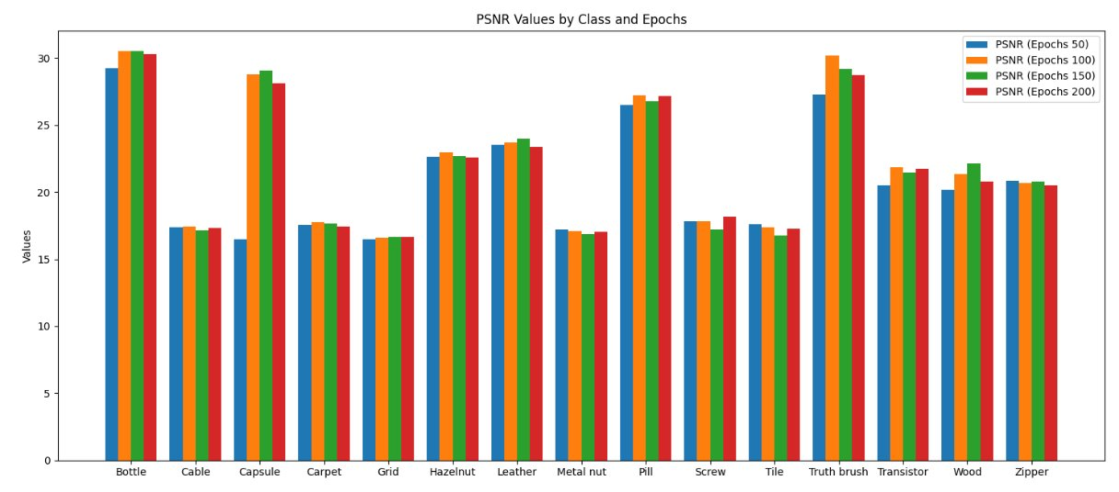
Class wise PSNR Results

Slide 24
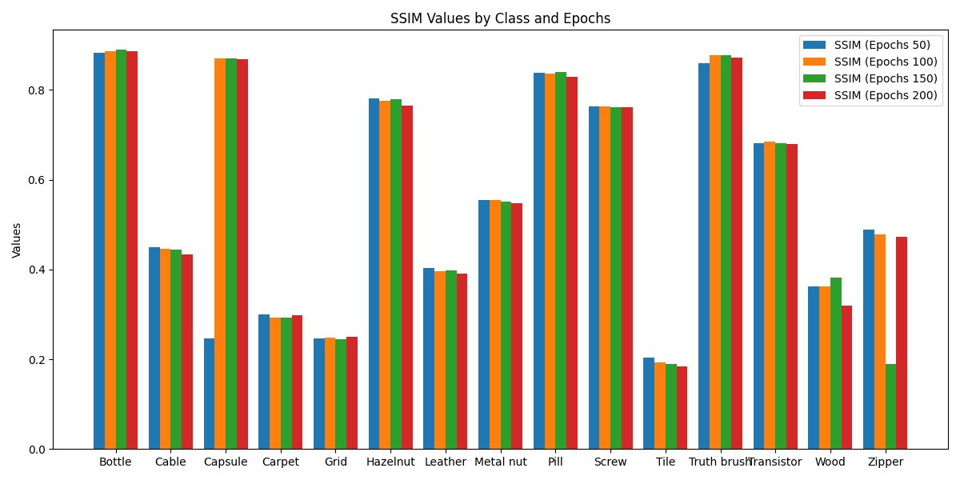
Class wise SSIM Results

Slide 25
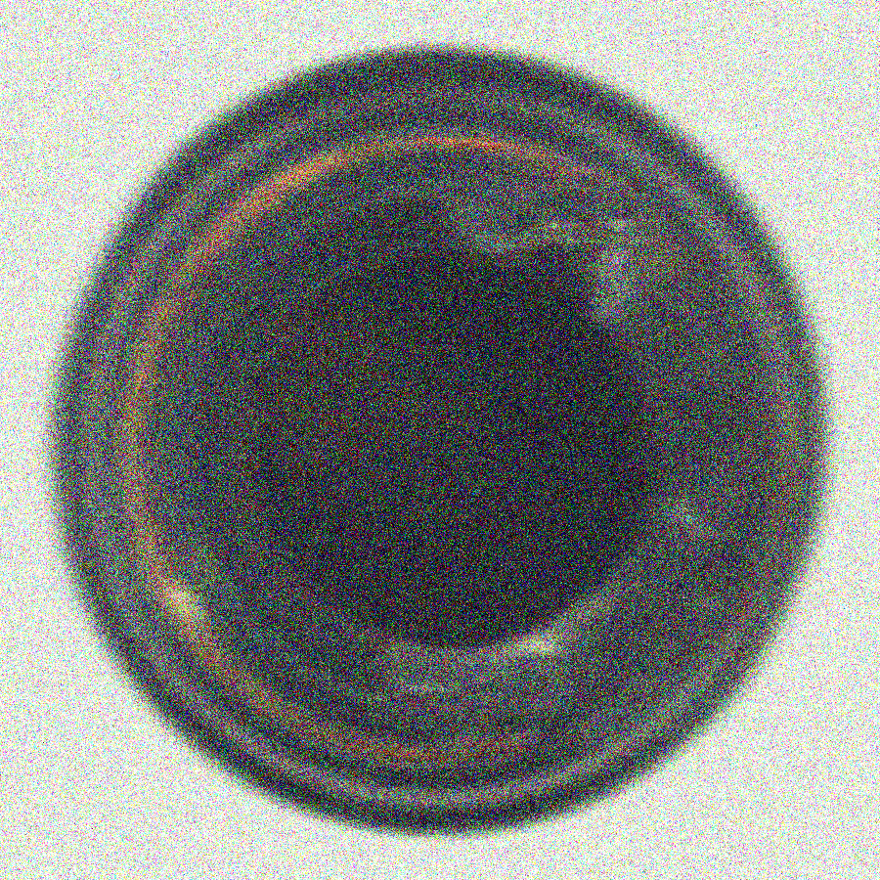
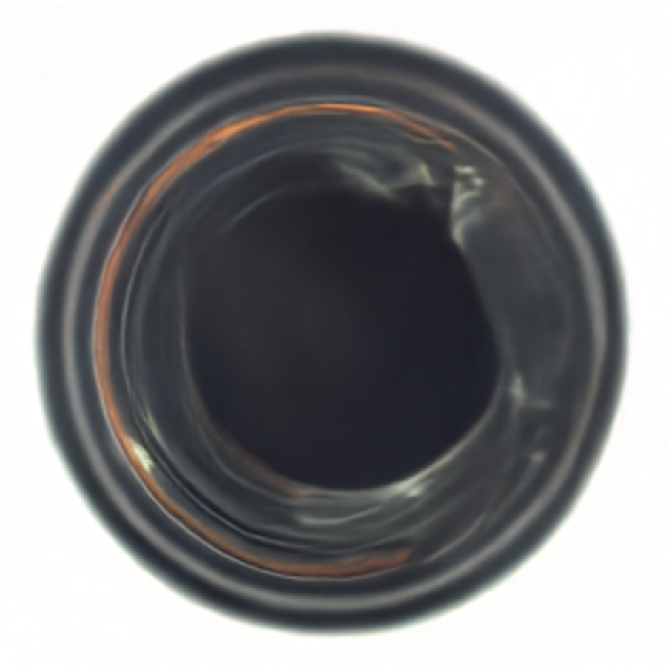
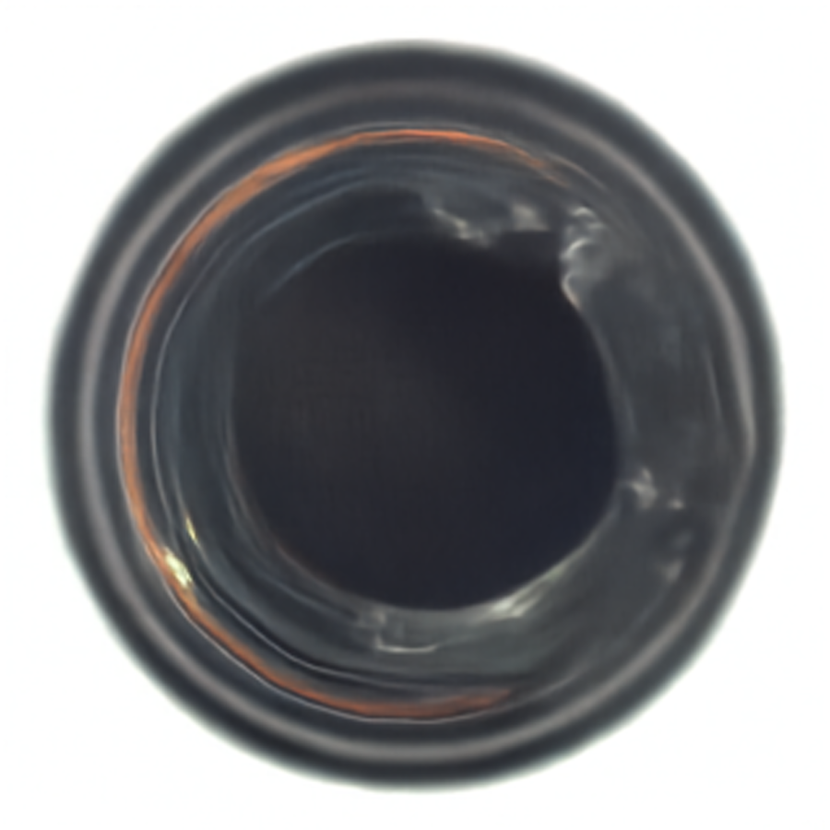
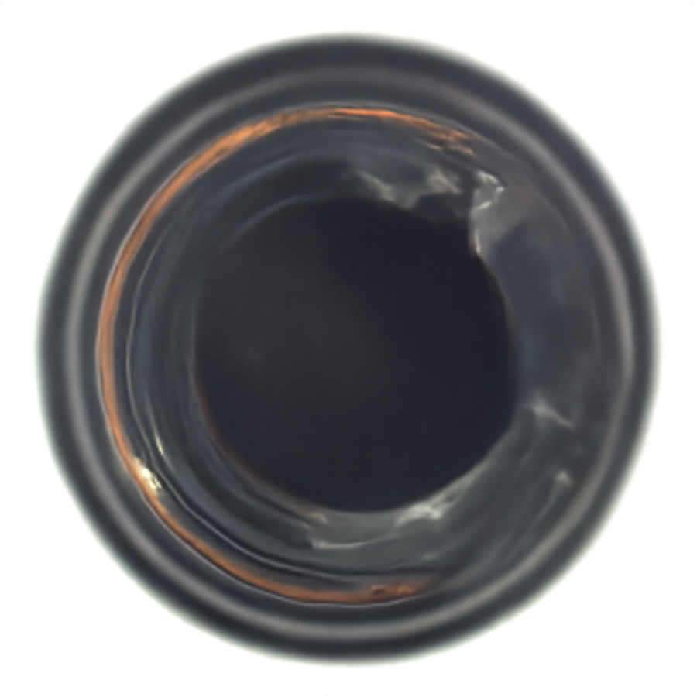
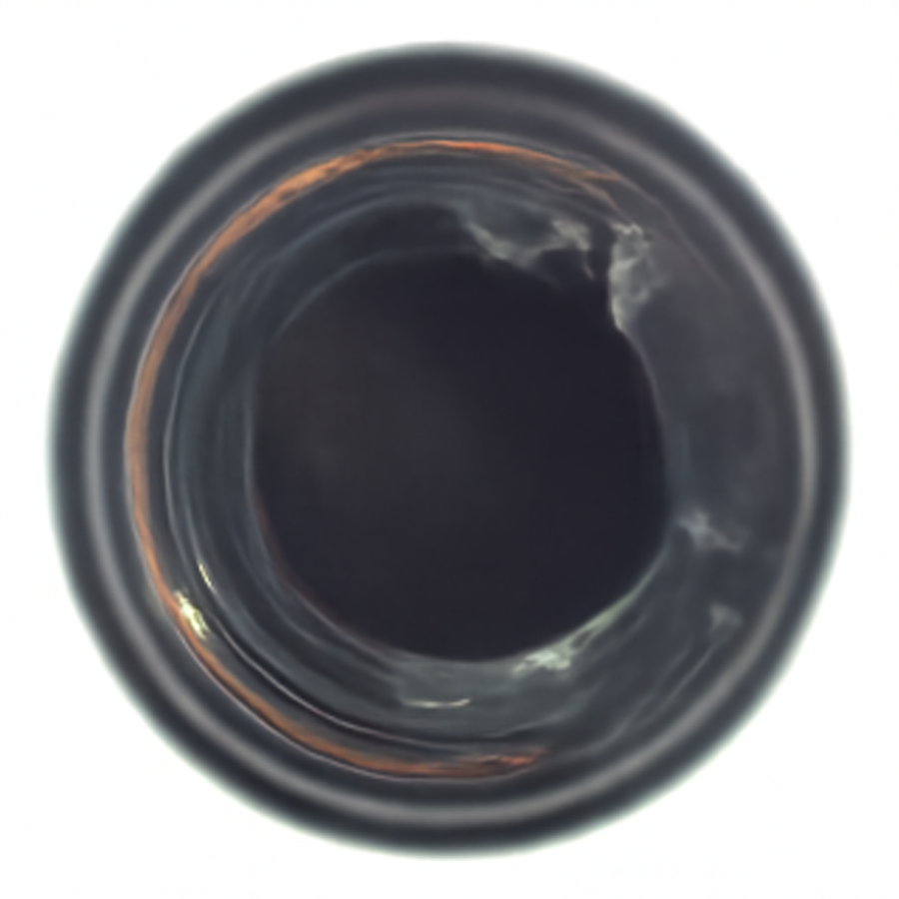

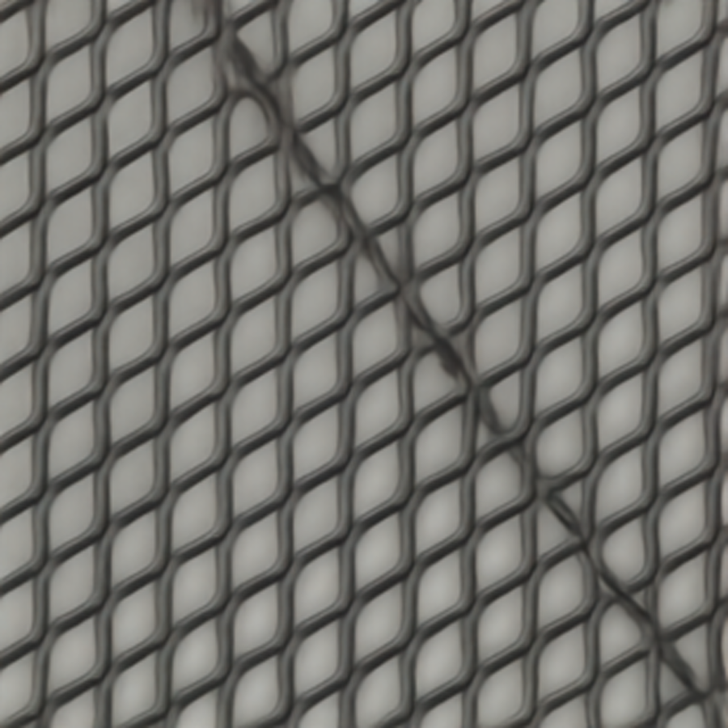


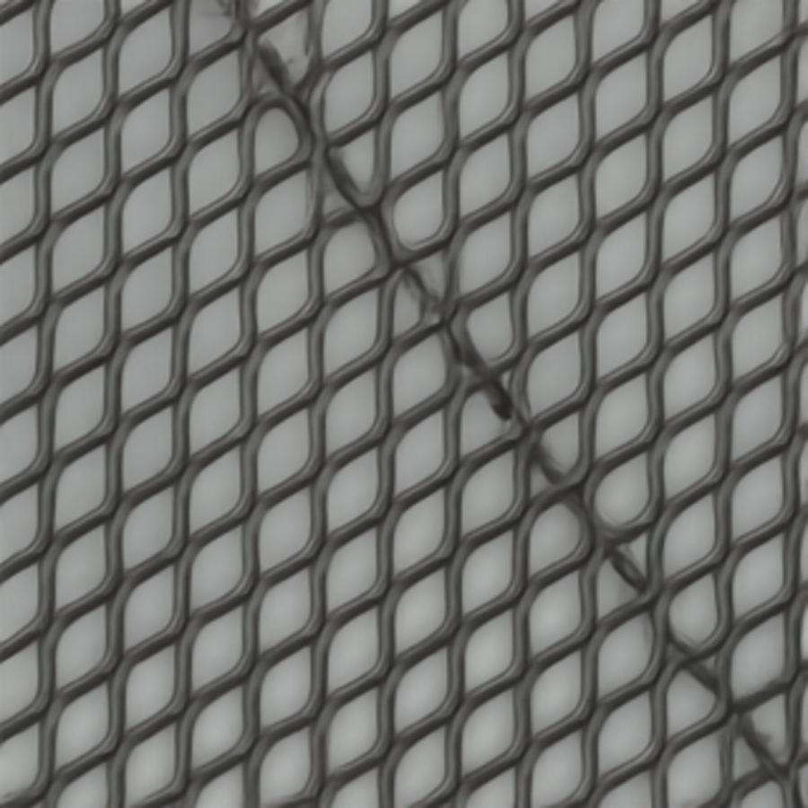
Results
Ground Truth Image | Epochs = 50 | Epochs = 100 | Epochs = 150 | Epochs = 200
Bottle
Grid

Slide 26
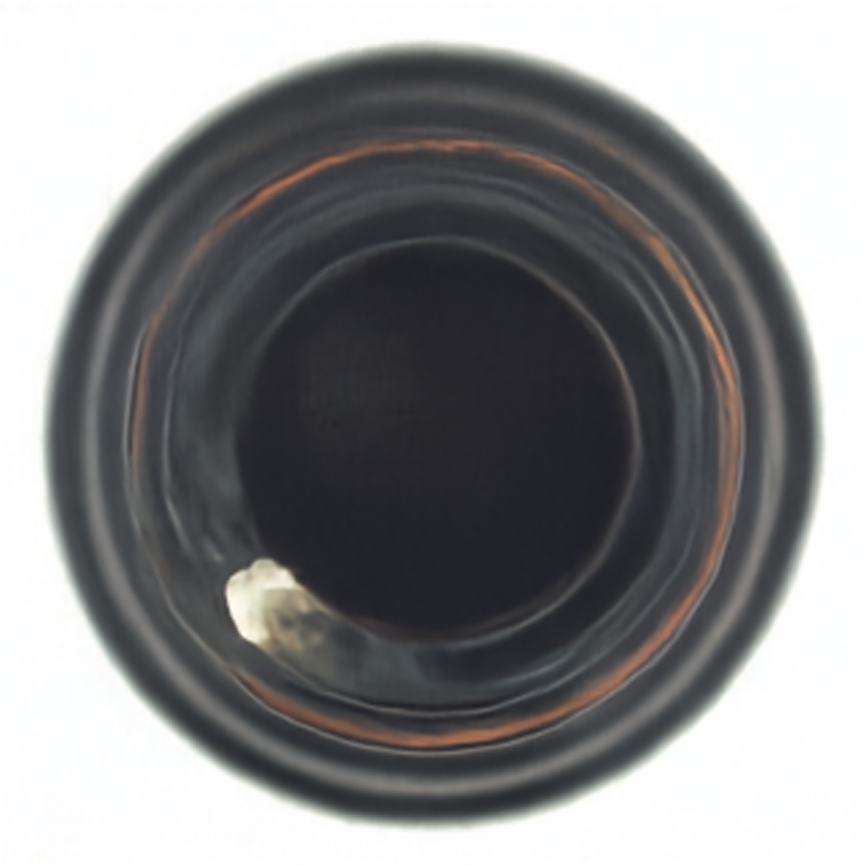
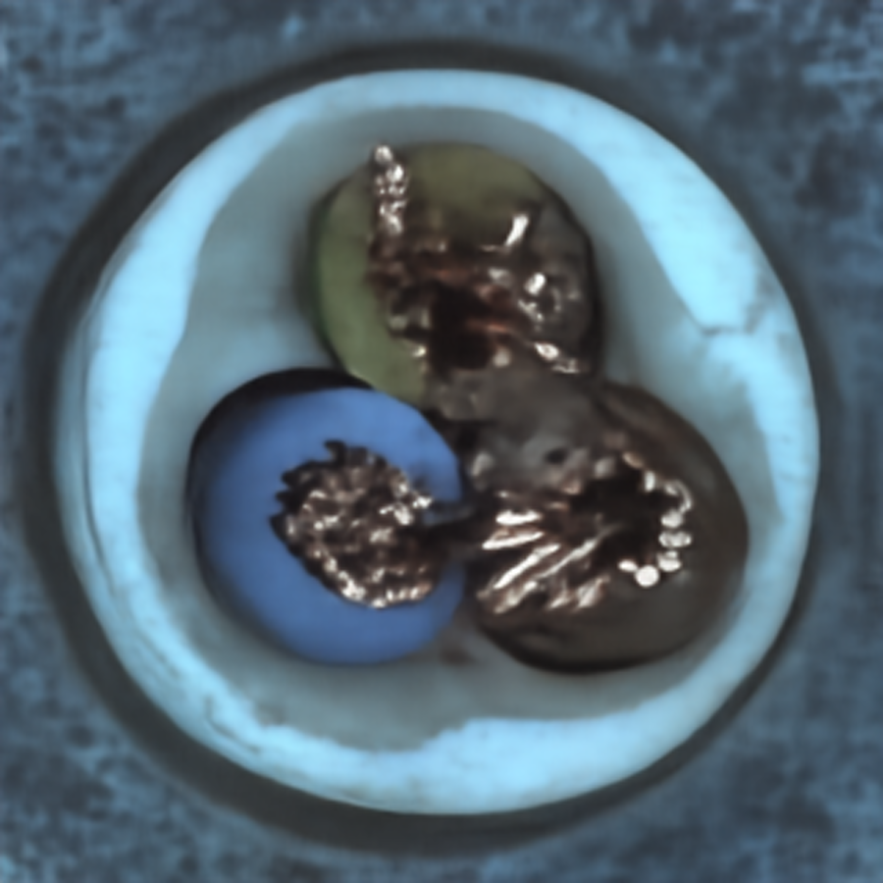
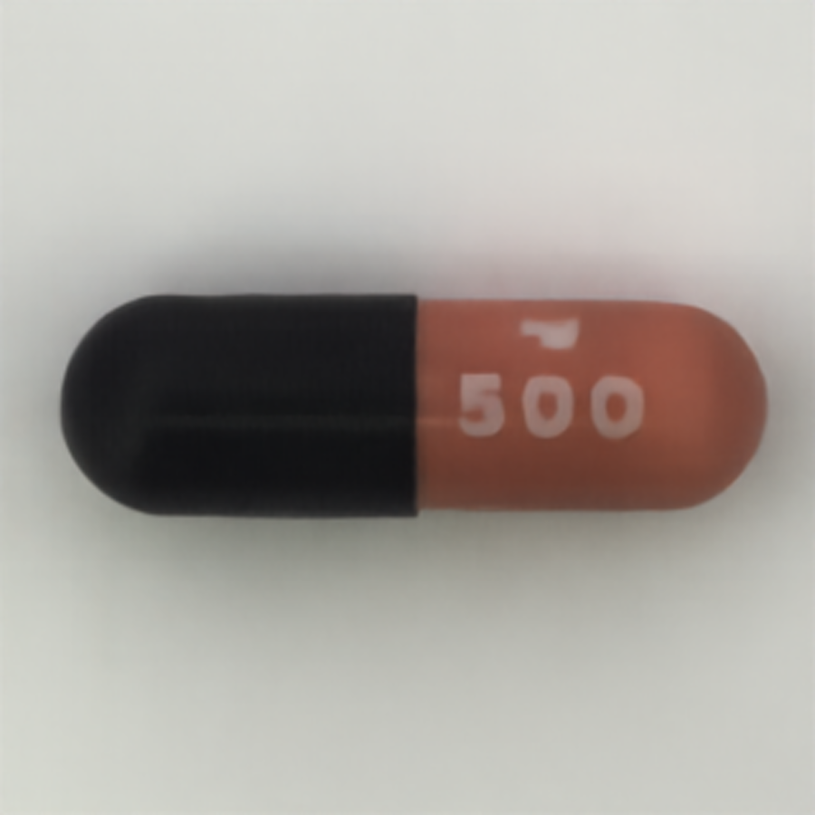
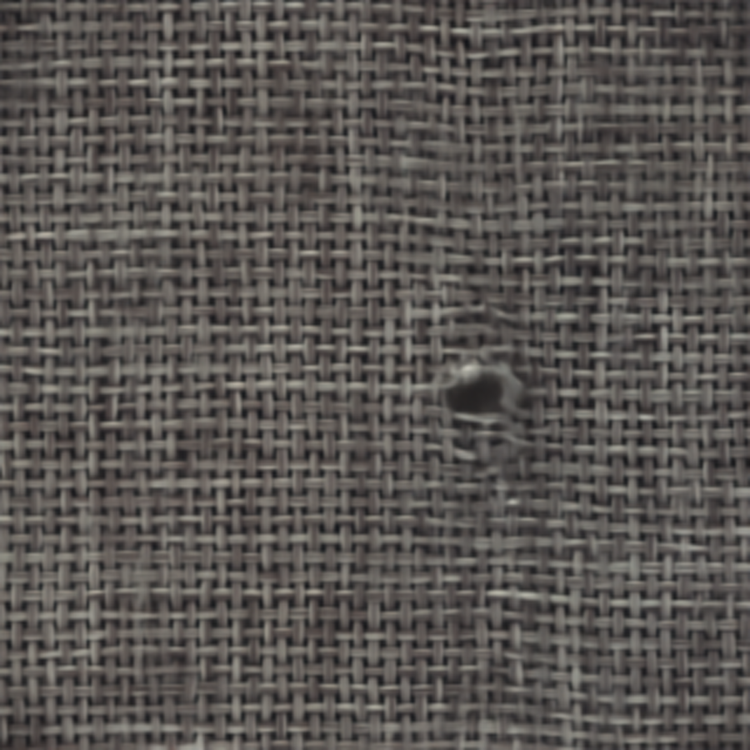

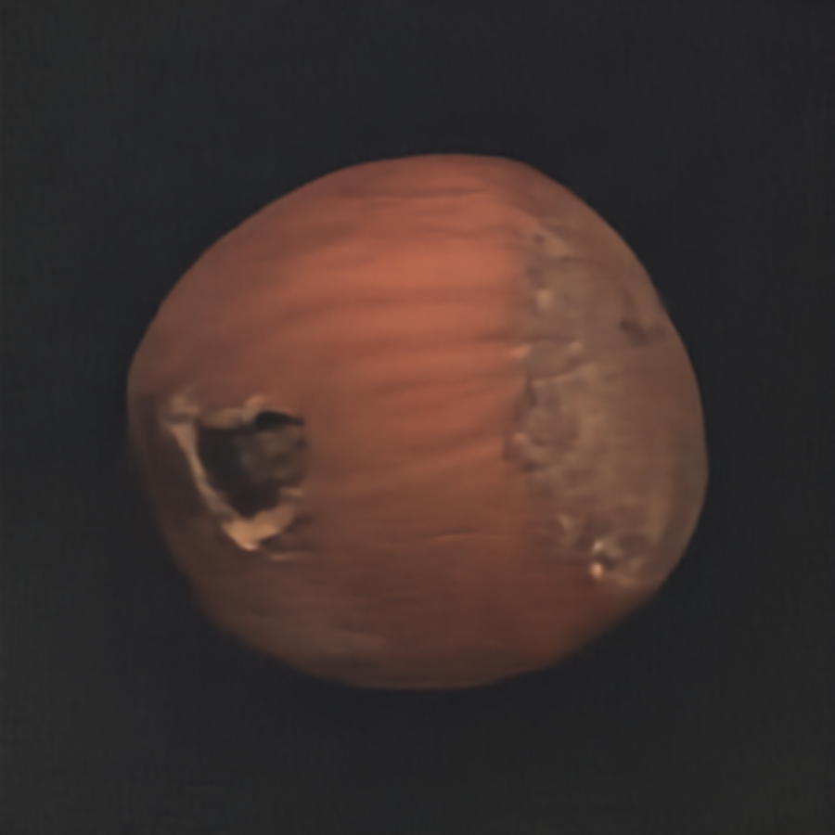
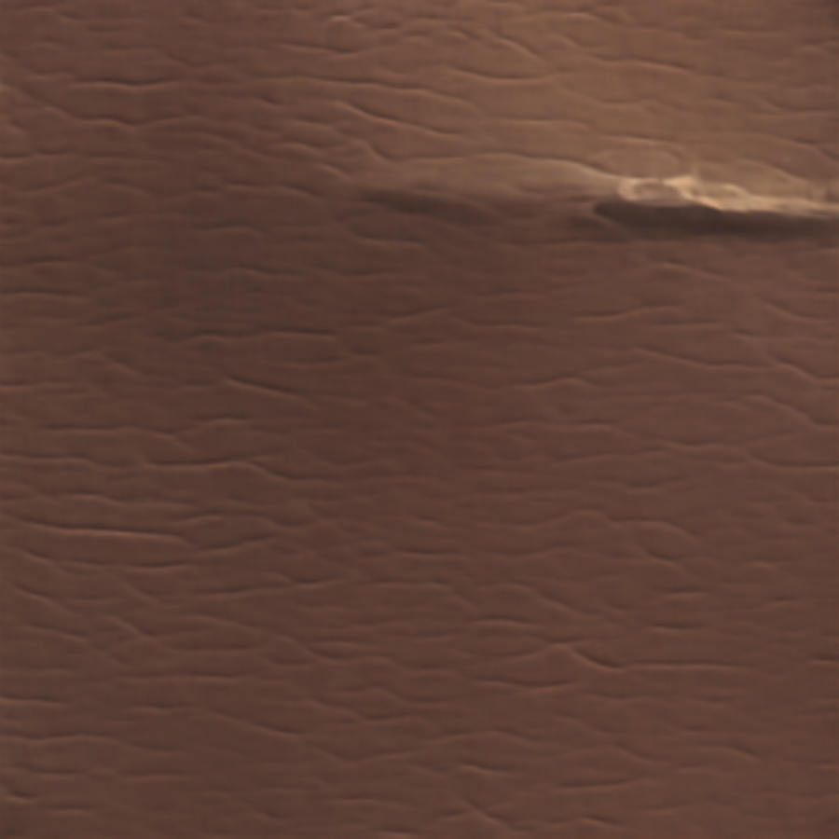
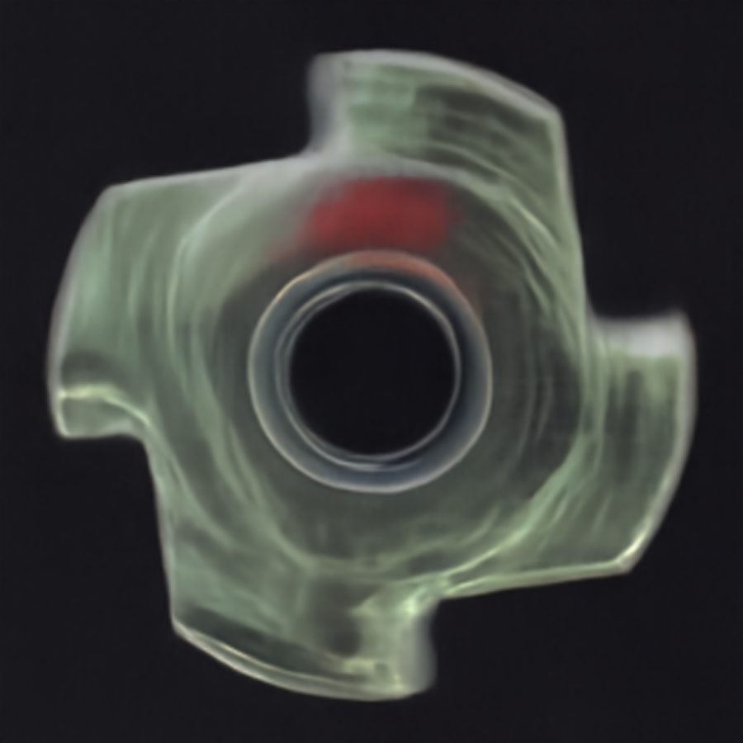
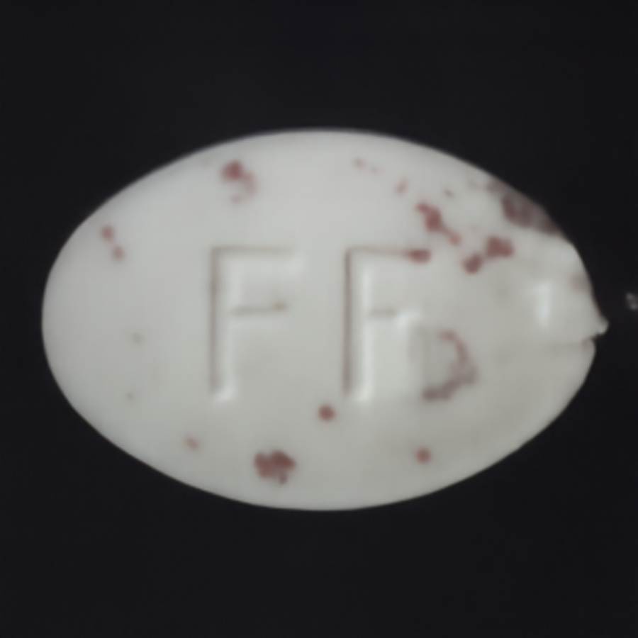
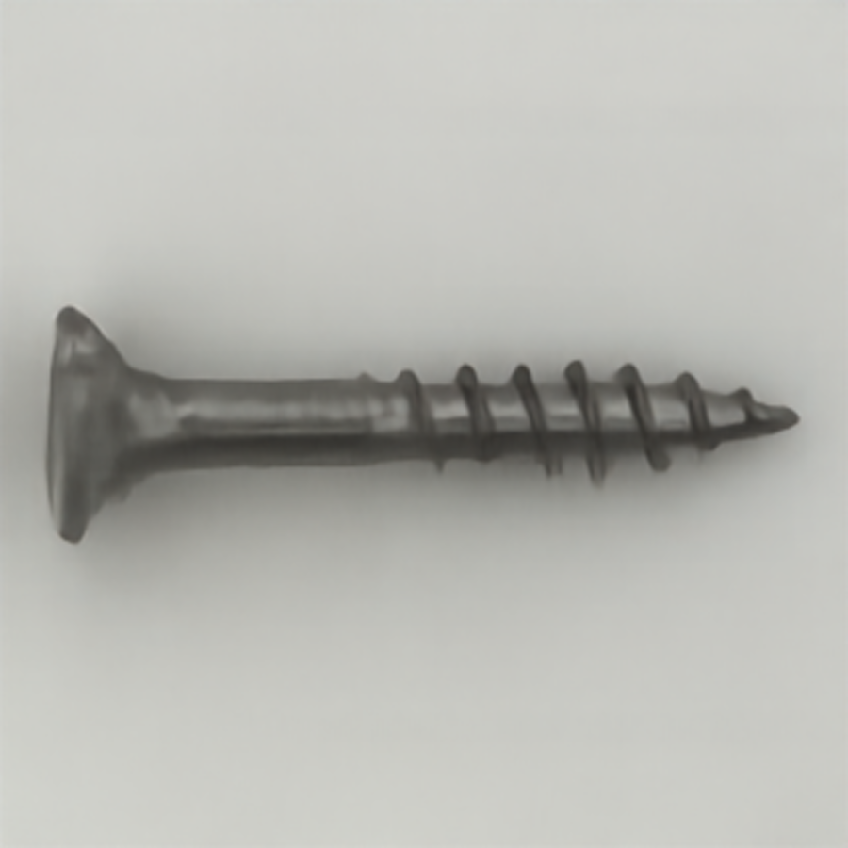
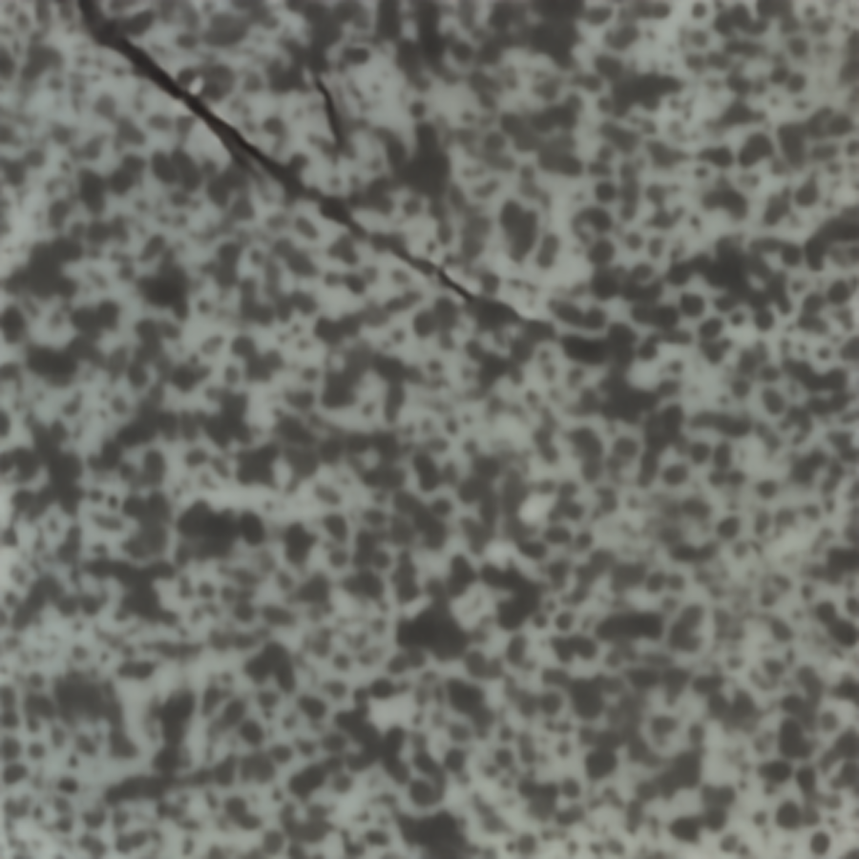
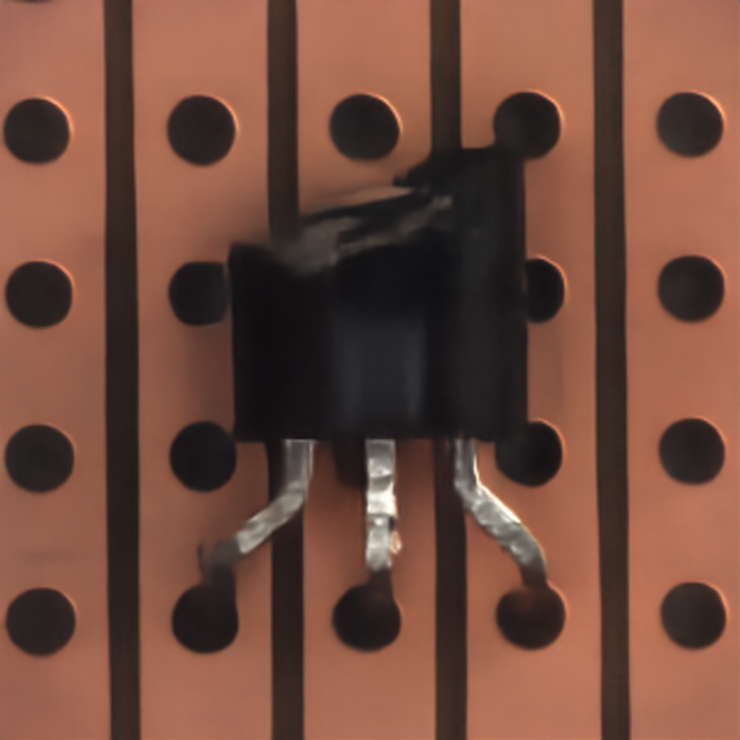
Class wise results for 100 Epochs (Best model)

Slide 27
Conclusion
The model converges at 100 Epochs and there seems to be no further improvement post that.
Average PSNR : 22.0964
Average SSIM : 0.577
Optimiser : Adam
Learning rate : 1e-3

Slide 28
Notes
The Environment installations can be found at SCUNet/environment.txt
To Train the model : Run SCUNet/train.py
Example:
python3 train.py --model_name scunet_color_real_gan --testsets ./Denoising_Dataset_train_val/bottle/Train/Degraded_image/ --results ./scunet_50epochs/ --ground_truth_name /home/asl/Muni/EE5179/project/Denoising_Dataset_train_val/cable/Train/GT_clean_image/
To verify the results: Run SCUNet/verification_script.sh. Verify the paths present in the script and also give the name of the target model at line 45. The trained models are saved in the SCUNet/model_zoo folder/new_model99 refers to the model trained for 100 Epochs

Slide 29
Convolutional AutoEncoder Report

Slide 30
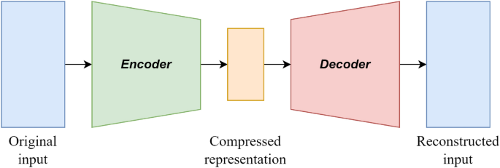
CNN Auto Encoder Architecture

Slide 31
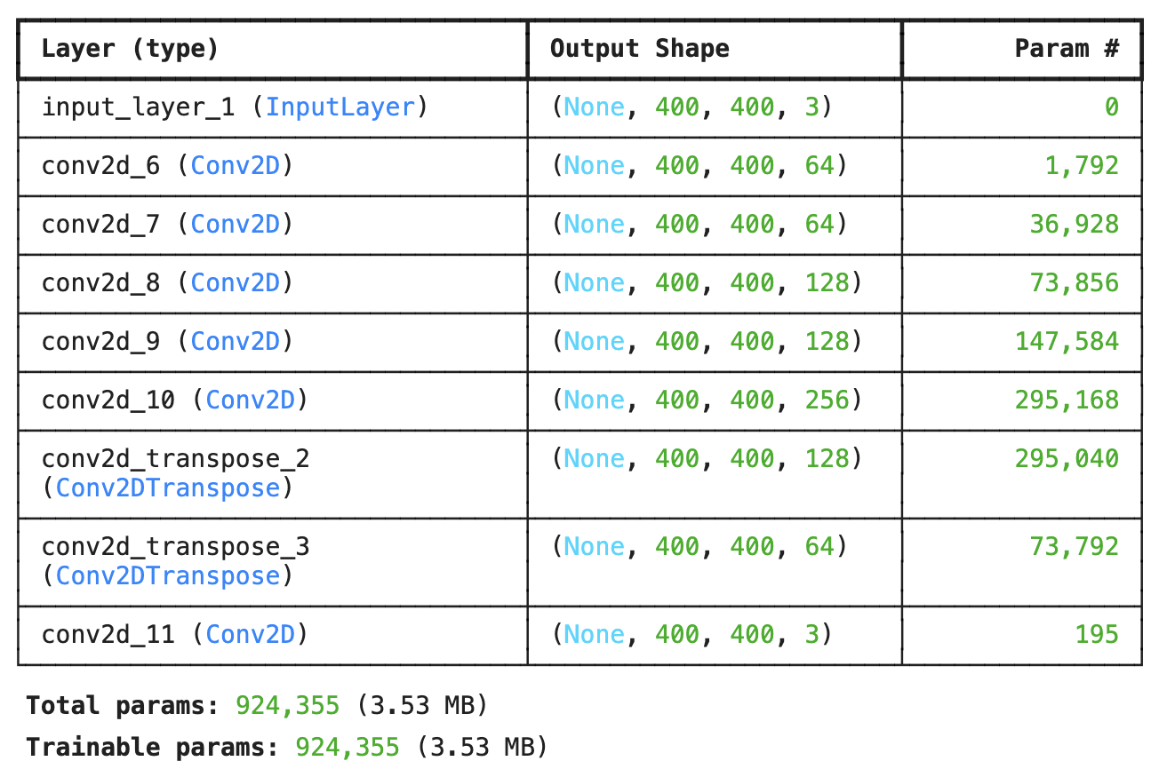
Model Parameters:

Slide 32
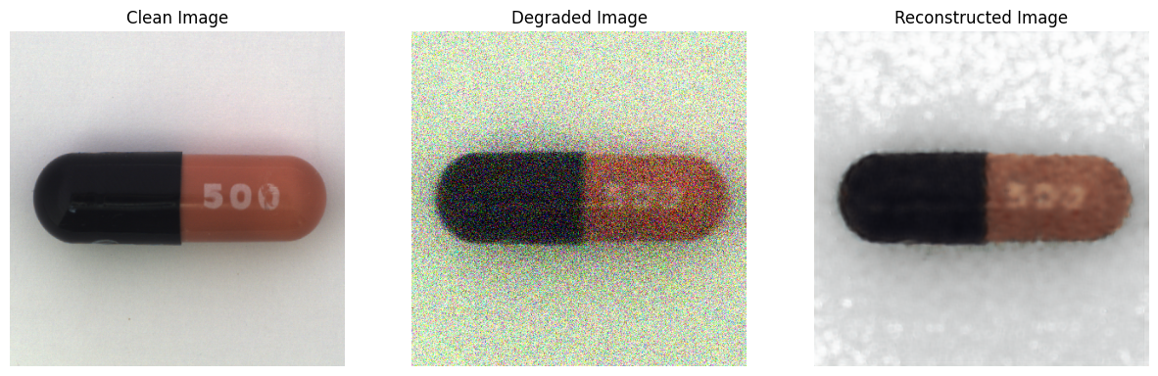
Results
Epochs | 50 | 100
Average PSNR | 12.79 | 12.83
Average SSIM | 0.45 | 0.48

Slide 33
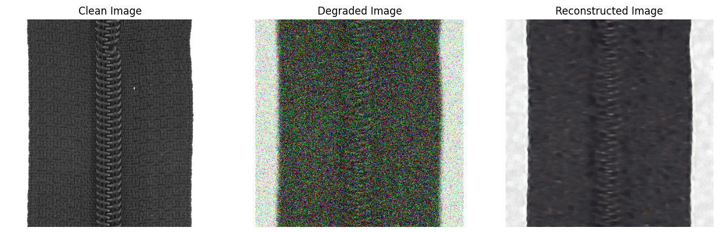
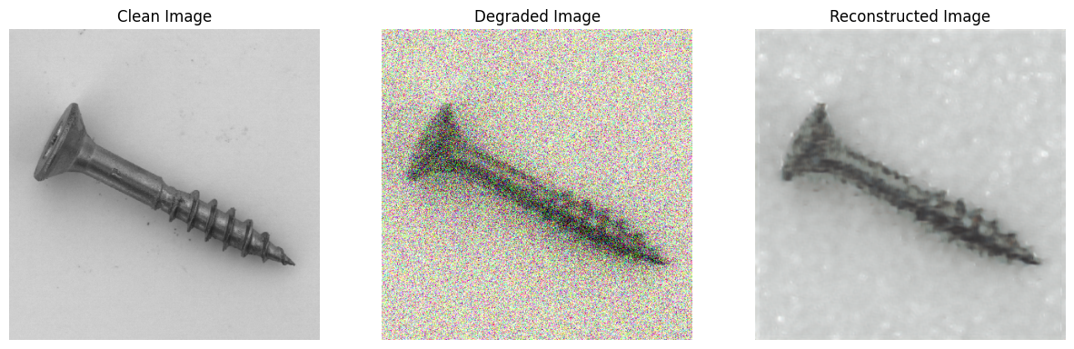

Slide 34
Conclusion
The model converges at 100 Epochs.
Average Validation PSNR : 12.8
Average Validation SSIM : 0.48
Optimiser : Adam

Slide 35
U Net

Slide 36
Paper Details:
UNet-based model for crack detection integrating visual explanations
https://www.sciencedirect.com/science/article/pii/S0950061821039957

Slide 37

Model Architecture – UNet

Slide 38
Number of images: 932
Number of epochs: 50
Gradient clipping: True
Optimizer: Adam
Weight Decay: 1e-4
Betas: [0.9, 0.999]
Metric: PSNR, SSIM
Training details:

Slide 39
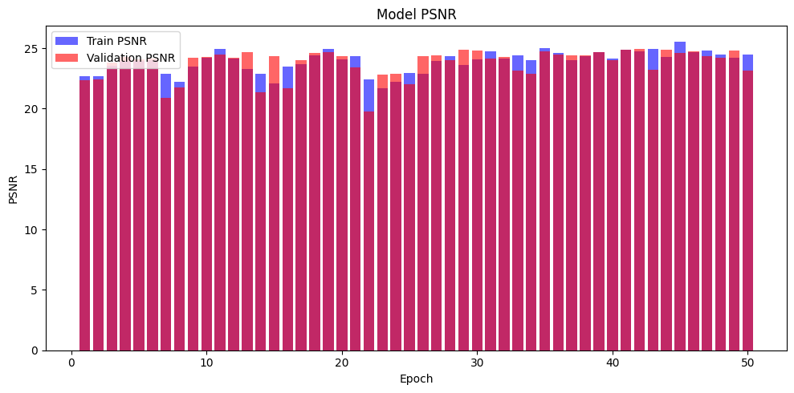
Model PSNR plot:

Slide 40
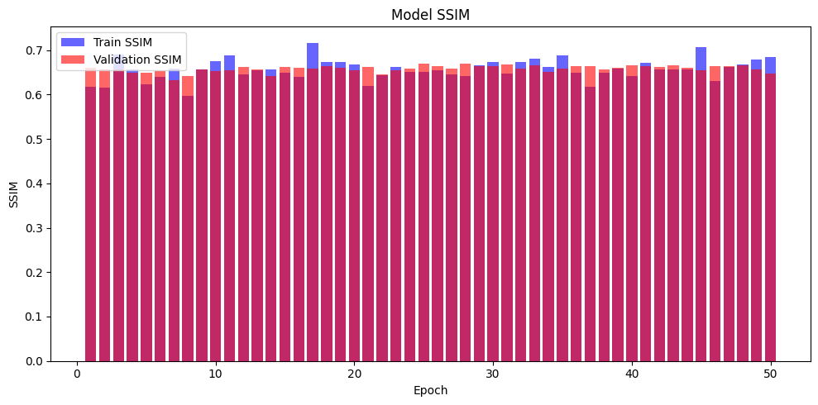
SSIM Plot:

Slide 41
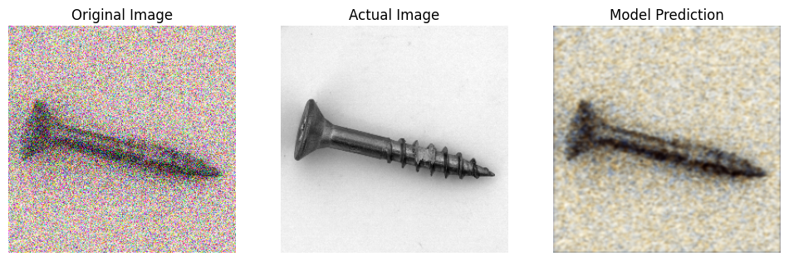

Constructed image:

Slide 42
Conclusion:
Average Training PSNR: 23.90
Average Validation PSNR: 23.78
Average Training SSIM: 0.66
Average Validation SSIM: 0.66

